Slide 1

Branch Diver Lectures

Slide 2
Version History – hidden slide
Version | Date | Who | What changed
2.0 | Sep06 | HQ | Released as Version Sport Diver Lecture_2_-Ears_Sinuses_and_Pressure
3.0 | Apr14 | Alastair McCulloch | Updated to reflect new Training Schedule with addition of Branch Diver Grade. Lecture renumbered as BDL3 to match the new syllabus. Basic Buhlmann and DCI info added from old Sport Dover Lecture 11 – Decompression. SSAC changed to ScotSAC throughout. Added hidden version history slide. Email address for feedback added to closing slide. Added footers with Lecture number and Page number to slides.

Slide 3
Lecture BDL3
Ears, sinuses and effects of pressure.
Introduction to Buhlmann tables including safety stops

Slide 4
Overview
Pressure
Partial Pressure – Dalton’s Law
Pressure and Volume – Boyle’s Law
Other Gas Laws
Air Spaces in the Human Body
Ears, Sinuses and Lungs
DCS Introduction
Use of Buhlmann Tables

Slide 5
Pressure
Air pressure is caused by the weight of air molecules in the atmosphere exerting a ‘pressing’ force. It is called atmospheric pressure and is measured in bar
At sea level, the atmospheric pressure is 1 bar. At higher altitudes, the pressure decreases as the ‘weight of air’ above the ground is less.
Entering the sea and going progressively deeper, the pressure is the combination of both the air and the water force
Air
Column
Depth
Ambient
Pressure
0m
(Sea level)
1 bar
10m of water will exert the same pressure as that exerted by the whole atmosphere - Each 10 metres of water results in another bar of pressure
Gauge and atmospheric pressure
10m
2 bar
20m
3 bar
30m
4 bar

Slide 6
Partial pressure – Dalton’s Law
Air is a mixture of gases, containing approximately 80% nitrogen, 20% oxygen and other trace gases
Dalton’s Law of Partial Pressures
The sum of the partial pressures in a mixture of gases is equal to the total pressure of that gas. (Assumes constant temperature and volume)
For example, since air has 80% nitrogen and 20% oxygen, 80% of the pressure is caused by the nitrogen and 20% by the oxygen

Slide 7
Dalton’s Law - Examples
1 bar
2 bar
3 bar
4 bar
5 bar
0m
0.80
0.20
10m
1.60
0.40
20m
2.40
0.60
30m
3.20
0.80
40m
4.00
1.00
Air at 1 bar pressure (sea level):
Partial pressure of nitrogen = 80% of 1 bar = 0.8 bar
Partial pressure of oxygen = 20% of 1 bar = 0.2 bar.
Air at 4 bar pressure (30m):
Partial pressure of nitrogen = 80% of 4 bar = 3.2 bar
Partial pressure of oxygen = 20% of 4 bar = 0.8 bar

Slide 8
Pressure and Volume – Boyle’s Law
Boyle’s Law
Pressure varies inversely with volume, i.e. the greater the pressure, the smaller the volume will be.
A balloon blown up on the surface will half in volume if taken to 10m. By 30m it will have quartered
This relationship is fundamental to diving. Any air space will be affected by it including our lungs and the air in our BCD and suit
Depth
(m)
Pressure (bar)
Volume
0
1
One
10
2
Half
20
3
Third
30
4
Quarter
Mathematically:
P₁V₁=P₂V₂
P₁= initial pressure V₁= Initial volume
P₂= final pressure V₂= final volume
(for a fixed temperature)

Slide 9
Boyle’s law and ascent
Surface
10m
20m
30m
40m
500%
250%
166%
125%
100%

Slide 10
Other Gas Laws
Gasses dissolved in a liquid:
Henry’s Law is very important when understanding the causes of decompression sickness. It governs the way in which our body absorbs and releases nitrogen. This will be discussed fully in later lectures
Henry’s Law
The amount of gas that dissolves in a liquid with which it is in contact is proportional to the partial pressure of that gas.
Pressure and Temperature:
Important to consider for cylinder filling
Charles’ law (Gay-Lussac)
For any gas at constant volume, the pressure of the gas will vary directly with the absolute temperature

Slide 11
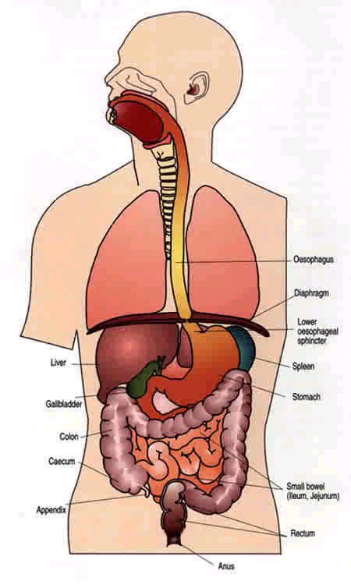
Air spaces in the human body
Air is held in the human body in a variety of places. The main locations are: the ears; the sinuses; the respiratory airways; the lungs; the stomach and the gut
The rest of the human body can be assumed to be either liquid or solid and is not affected by pressure to the same degree
Any compressible airspace in the diver’s body will be affected by pressure and will vary in volume, according to Boyle’s Law
As a diver descends, the increasing pressure will compress the air spaces in the body into a smaller volume (known as ‘squeeze’)
Similarly, on ascent, the reverse occurs and the air spaces will expand as the pressure decreases
WWW.PNC.COM.AU/TALLEY/IMAGES

Slide 12
Ears
Ears are very sensitive to pressure. They can be affected within about 2 metres of leaving the surface
Increasing external water pressure will force the air in the middle ear to compress, pushing the eardrum inwards and causing feelings of discomfort
Aural Barotrauma
Ear Clearing / Valsalva manoeuvre
Reversed Ear
Ear-plugs should never be worn
Never dive with a cold or other respiratory infection

Slide 13
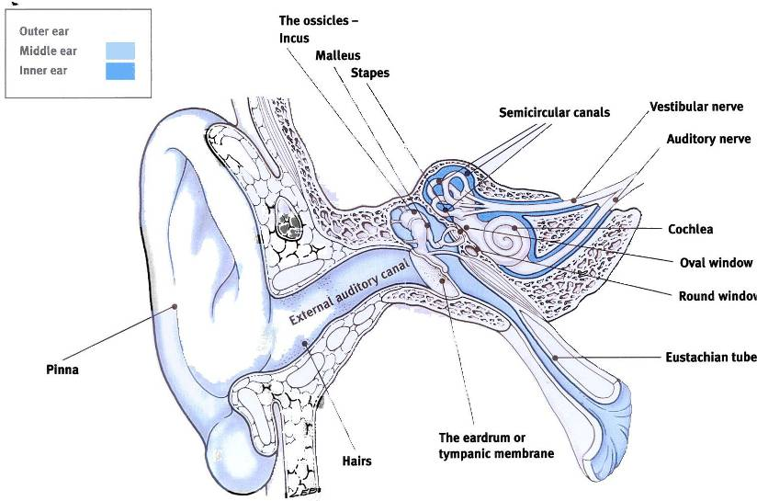
The Ear

Slide 14
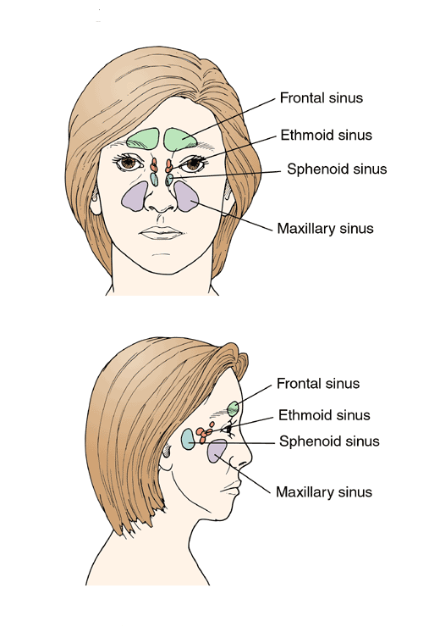
Sinuses
  What are sinuses?
    Frontal Sinus
    Ethmoid Sinus
    Sphenoid Sinus
    Maxillary Sinus
  Pressure Equalisation
  Effect of cold/ nasal infection/ hayfever
  Decongestant medicine
Source: University of Michigan

Slide 15
Lungs
Lungs
  Compression of air in lungs
  Effect of breathing compressed air at ambient pressure
  Effect of a cold
  Breath holding on ascent
  Pulmonary Barotrauma
NEVER HOLD YOUR BREATH FOR ANY REASON
NEVER DIVE WITH A COLD
BREATHE NORMALLY AT ALL TIMES
WWW.PNC.COM.AU/TALLEY/IMAGES

Slide 16
Air Spaces
Pain caused by air cavities in dental fillings (Dental Barotraumas)
Certain foods produce excessive gas during digestion, if the movement of this gas is restricted, discomfort will result
In severe cases bowel tissue can rupture causing Gastrointestinal Barotraumas
Divers should refrain from eating gas-producing foods and drinking fizzy drinks before a dive
Mask squeeze can happen upon descent as the compressible space in the mask reduces in volume with depth, causing discomfort
This can be equalised by breathing air from the nose into the mask

Slide 17
DCS Introduction and use of Buhlmann Tables

Slide 18
Decompression Sickness – The Risk
Every time you dive you are putting yourself at risk from decompression sickness (DCS)
All dives are potentially dangerous however the risk is limited at the Branch Diver limit of 15m
Use of decompression tables make diving safer, but do not guarantee 100% safety
It is important you understand the cause of DCS, recognise symptoms and know the key first aid step

Slide 19
Cause of DCS – Nitrogen absorption
Our body ABSORBS more nitrogen (N₂) during diving due to the increased partial pressure of N₂ at depth
The LONGER and DEEPER the dive, the more N₂ our body absorbs
Some body tissues will absorb and release N₂ more rapidly than others depending on the fat content of the tissue and the blood supply to it. Fast tissues include the brain, heart and muscles. Slow tissues include cartilage and tendons
On ascent the pressure decreases and our body begins to release N_{2.}
If a diver ascends too quickly the N₂ in their bloodstream will come out of solution, forming small bubbles in the blood (a similar thing happens when you open a fizzy juice bottle too quickly!)
The bubbles which form can travel around the body, lodging themselves in certain areas, blocking blood flow, causing pains in the joints and other more serious effects

Slide 20
Controlled ascents and stops
In order to minimise the chance of bubble formation, a maximum ascent rate of 10m per minute is recommended
In addition, a minimum 1 min safety stop at 3m must be carried out on ALL dives. This allows more time for the body to release N₂ giving a larger safety margin
Even with a safety stop, excess N₂ will still be present in your body for some time after surfacing. It can take several hours, or even days for your body to return to normal levels
On longer or deeper dives, the body absorbs more N₂ than it can release safely on a normal ascent. Decompression stops at set depths and times are required to ascend safely

Slide 21
Decompression Avoidance
Always ascend in a controlled manner. Never exceed 10m per minute
Never miss a safety or decompression stop. Both are necessary to release N₂ from your body and prevent the formation of bubbles
Physiological factors
  Improve your overall fitness
  Drink plenty of water in the run up to a dive
  Don’t dive if you feel off colour
Dive Practices
  Limit depth and bottom time (15m limit for qualified Branch Diver)
  Avoid poor profiles and repetitive deep dives
  Do not ascend mountains or fly immediately after diving as the reduced partial pressure of N₂ at altitude may lead to symptoms of DCS
  Avoid over exertion during and after a dive as this may induce DCS
  Avoid decompression diving (not permitted for Branch Divers)

Slide 22
Safety Stops
Bubble Count
No Safety Stops
120
100
2 mins @ 3 metres
4 min @ 3 metres 1 min @ 6 metres
80
60
Remember
there is no
such thing
as a no stop
dive
40
20
10 20 30 40 50 60 70 80 90 100 120
Surface interval in minutes

Slide 23
Decompression Tables
Decompression tables are based on theoretical models of N₂ diffusibility in tissues
There are many types of tables available. ScotSAC have opted to use a Buhlmann based system. For altitude dives, other tables are required
This assumes a ‘square profile’ dive giving an index of decompression stops required for a given depth and duration of dive
Bottom Time is the time from leaving the surface to beginning ascent (square profile) or to reaching 9m on ascent (variable profile)
A repetitive group letter (RGL) is also given indicating the amount of excess N₂ remaining in a divers body after a dive
A penalty system is used to account for excess N₂ when planning a second dive

Slide 24
Working with Buhlmann tables
PLAN THE DIVE !!
TABLE 1
For Depth and Time
RG letter
For exit
Surface Interval
Table 2
Use RNT to plan depth and Time
Plan Next dive and get Re-entry RG
TABLE 3
RNT

Slide 25
Working with Buhlmann Tables -1
Buhlmann profile
  Bottom time and depth
  Decompression stops
  Duration
  Exit RG
  Surface Interval
  Entry RG/ RNT for second dive
  No Fly time/ Desaturation
Surface Interval ___
DIVE 2
DIVE 1
____ Time out
____ Exit RG
3m___
6m___
9m___
Time in ___
Entry RG___
____ Time out
____ Exit RG
3m___
6m___
9m___
Time in ___
Depth ___
Depth ___
Bottom Time ___
Bottom Time ___
RNT ___

Slide 26
Working with Buhlmann tables -2
Worked Example: 1st Dive 9am 26mins @29m. SI 65mins
Depth (m)
BT
(min)
Stops
RG
1st Dive – Time in, depth and bottom time
Table 1:
Find depth (if not present go to next deepest)
Find time ( if not present go to next longest)
Read across for deco stops and exit RG
9m
6m
3m
30
9
1
A
11
1
B
16
1
C
17
1
D
25
5
E
30
2
7
F
Surface Interval ___
35
5
14
G
9.38 Time out
_F__ Exit RG
3m_7 min_
6m_2 min_
9m______
Time in ___
Entry RG_
____ Time out
____ Exit RG
3m___
6m___
9m___
DIVE 1
DIVE 2
9am
Time in ___
29m
Depth ___
Depth ___
26min
Bottom Time ___
RNT ___
Bottom Time ___

Slide 27
Working with Buhlmann tables-3
Worked Example: 1st Dive 9am 26mins @29m. SI 65mins
2nd Dive 25mins @22m
Enter table 2, using Exit RG and SI to
work out entry RG
Table 2
A
2
2
B
20
2
2
C
10
25
3
3
D
10
15
30
3
3
E
10
15
25
45
4
3
F
20
30
45
75
90
8
4
G
25
45
60
75
100
130
12
5
F
E
D
C
B
A
0
Time to Fly
Surface Interval ___
65 min
10.43
(minutes)
(hours)
9.38
F
____ Time out
____ Exit RG
3m___
6m___
9m___
DIVE 1
____ Time out
____ Exit RG
3m___
6m___
9m___
Time in ___
Entry RG___
DIVE 2
9am
C
Time in ___
7min
2min
29m
Depth ___
Depth ___
26min
Bottom Time ___
RNT ___
Bottom Time ___

Slide 28
Working with Buhlmann tables -4
Worked Example: 1st Dive 9am 26mins @29m. SI 65mins
2nd Dive 25mins @22m
RG
RNT for repetitive dives
Next Dive Depth (m)
Enter Table 3 to work out penalty for next dive
(residual nitrogen time)
If depth not available go SHALLOWER to incur
Bigger penalty
9
12
15
18
21
24
27
A
25
19
16
14
12
11
10
B
37
25
20
17
15
13
12
C
55
37
29
25
22
20
18
D
81
57
41
33
28
24
21
E
105
82
59
44
37
30
26
F
130
111
88
68
53
42
35
Surface Interval ___
65 min
10.43
9.38
F
____ Time out
____ Exit RG
3m___
6m___
9m___
DIVE 1
____ Time out
____ Exit RG
3m___
6m___
9m___
Time in ___
Entry RG___
DIVE 2
9am
C
Time in ___
7min
2min
29m
Depth ___
22 m
25min
22 min
Depth ___
26min
Bottom Time ___
RNT ___
Bottom Time ___

Slide 29
Working with Buhlmann tables -5
Worked Example: 1st Dive 9am 26mins @29m. SI 65mins
2nd Dive 25mins @22m
Depth (m)
BT
(min
Stops
RG
2nd Dive Decompression
Find depth (if not present go to next deepest)
Find time (BT+RNT=25+22=47 mins)
( if not present go to next longest)
Read across for deco stops and exit RG
9m
6m
3m
24
11
1
A
13
1
B
20
1
C
25
1
E
35
4
F
40
8
F
Surface Interval ___
65 min
10.43
50
17
G
11.27
G
17
9.38
F
____ Time out
____ Exit RG
3m___
6m___
9m___
DIVE 1
____ Time out
____ Exit RG
3m___
6m___
9m___
Time in ___
Entry RG___
DIVE 2
9am
C
Time in ___
7min
2min
29m
Depth ___
22 m
25min
22 min
Depth ___
26min
Bottom Time ___
RNT ___
Bottom Time ___

Slide 30
Working with Buhlmann tables -6
Worked Example: 1st Dive 9am 26mins @29m. SI 65mins
2nd Dive 25mins @22m
Table 2
A
2
2
B
20
2
2
Enter table 2 to calculate Desaturation and
No-Fly time using exit RG from dive 2
Desaturation 12 hrs
No Fly Time 5 hrs
C
10
25
3
3
D
10
15
30
3
3
E
10
15
25
45
4
3
F
20
30
45
75
90
8
4
G
25
45
60
75
100
130
12
5
F
E
D
C
B
A
0
Time to Fly
Surface Interval ___
65 min
10.43
(minutes)
(hours)
11.27
G
17
9.38
F
____ Time out
____ Exit RG
3m___
6m___
9m___
DIVE 1
____ Time out
____ Exit RG
3m___
6m___
9m___
Time in ___
Entry RG___
DIVE 2
9am
C
Time in ___
7min
2min
29m
Depth ___
22 m
25min
22 min
Depth ___
26min
Bottom Time ___
RNT ___
Bottom Time ___

Slide 31
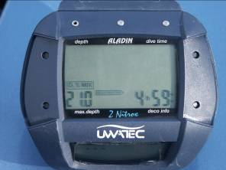
Computers
Dive computers consist of an internal clock and depth gauge which provides input to a microprocessor. This in turn uses a stored program/algorithm to continually recalculate the decompression requirements throughout the dive
Information displayed on screen may include elapsed dive time, current and maximum depth, ascent time to surface and decompression requirements. A dive planner and log book may also be included. Mixed gas and air integrated versions are available
Most models will also provide audible and visual warnings should ascent rate become too rapid
Actual dive profile
Assumed profile -table
Computer profile

Slide 32
Summary
Gas Laws
Air spaces in the body
Pressure and air spaces
Pressure laws are fundamental to diving
It is important that you understand them, and the different effects that they have
Decompression illness avoidance
Using the Buhlmann Tables

Slide 33
The End
Thank you for your attention
Any questions?

Slide 34
Please provide any feedback on these slides to hq@scotsac.com
Thanks.

